Slide 1


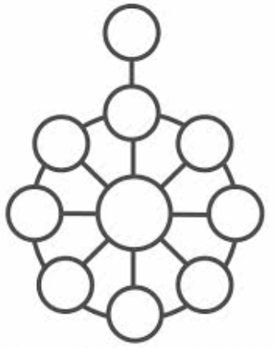



Slide 2



Build Ontology View on ArchiMate 3.2 Specification
001
Opening and Introduction

Slide 3

Build Ontology View on ArchiMate 3.2
002

